Slide 1

Methods for Causal Inference in Educational Research
January/February 2022
Isa Steinmann

Slide 2
5 | Regression Models Time: 31 January 2022, 12:15-14:00h Main instructor: Isa Steinmann Required reading: Angrist & Pischke (2015), chapter 2
6 | Further Control Strategies Time: 03 February 2022, 12:15-14:00h Main instructor: Isa Steinmann Required reading: -
7 | Instrumental Variable Approaches Time: 07 February 2022, 12:15-14:00h Main instructor: José Manuel Arencibia Alemán Required reading: Angrist & Pischke (2015), chapter 3
8 | Regression Discontinuity Designs I Time: 10 February 2022, 12:15-14:00h Main instructor: José Manuel Arencibia Alemán Required reading: Angrist & Pischke (2015), chapter 4

Slide 3

Take-away messages
RCT might raise several ethical concerns
The benefits from RCT can only be ripped if random assignment is well conducted
Special attention must be paid to the recruitment and assignment of conditions procedures
Generalizability and validity of results depends on successful implementation of randomization

Slide 4
Overview
Regressions for causal inference
Preschool example
Extended R exercise

Slide 5

https://www.youtube.com/watch?v=6YrIDhaUQOE
Notes:
10 minutes

Slide 6
Regressions for Causal Inference
“Regression-based causal inference is predicated on the assumption that when key observed variables have been made equal across treatment and control groups, selection bias from the things we can’t see is also mostly eliminated.”
Angrist & Pischke, 2015, p. 47

Slide 7
Regressions for Causal Inference
“Regression-based causal inference is predicated on the assumption that when key observed variables have been made equal across treatment and control groups, selection bias from the things we can’t see is also mostly eliminated.”
→ assumption that we can control for selection mechanisms by including good set of control variables (ceteris paribus)
→ if control variables do not capture whole selection mechanism, we have omitted variable bias, i.e., remaining selection bias
Angrist & Pischke, 2015, p. 47

Slide 8


Regressions for Causal Inference
“Regression-based causal inference is predicated on the assumption that when key observed variables have been made equal across treatment and control groups, selection bias from the things we can’t see is also mostly eliminated.”
→ assumption that we can control for selection mechanisms by including good set of control variables (ceteris paribus)
→ if control variables do not capture whole selection mechanism, we have omitted variable bias, i.e., remaining selection bias
OR
?
Angrist & Pischke, 2015, p. 47

Slide 9
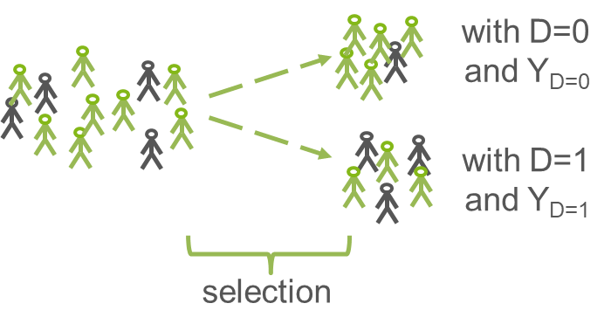
Regressions for Causal Inference
We need
knowledge about the selection mechanisms at play
good observed variables (associated with treatment allocation AND outcome) to capture the selection mechanisms
overlaps in characteristics between treatment and control groups
large enough datasets
appropriate regression model
Notes:
observed control variables preferably measured before outcome

Slide 10

What are selection mechanisms in
private vs. public college attendance
in the US?

Slide 11
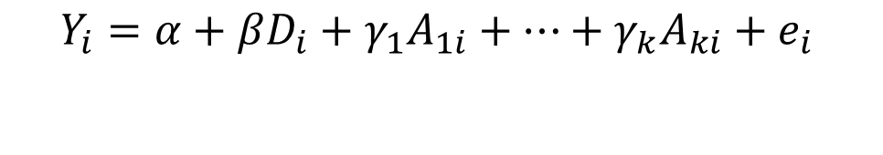
Regressions for Causal Inference
Outcome Y (in this case wage) is regressed on
treatment D (in this case 0 = public and 1 = private) and
set of k control variables A
Angrist & Pischke, 2015

Slide 12
Regressions for Causal Inference
Outcome Y (in this case wage) is regressed on
treatment D (in this case 0 = public and 1 = private) and
set of k control variables A
SAT scores, parental income, gender, race, high-school rank, athlete
150 selectivity groups (i.e., college types they applied for and were admitted to) → comparing students who were admitted to similar schools and did vs. did not go
Angrist & Pischke, 2015

Slide 13
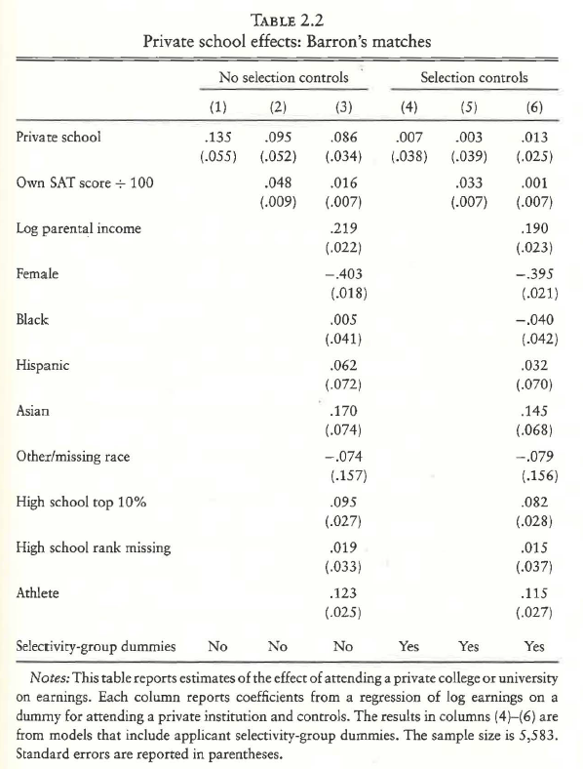
Angrist & Pischke, 2015, p. 63

Slide 14
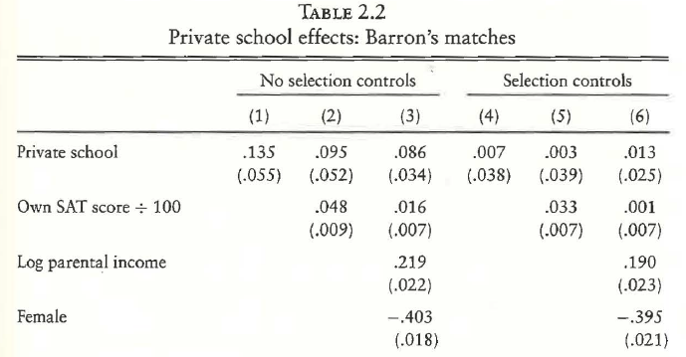
→ if other things are controlled for (and hopefully equal), no significant wage premium of private school
Angrist & Pischke, 2015, p. 63

Slide 15
Regressions for Causal Inference
“Regression is a way to make other things equal, but equality is generated only for variables included as controls on the right-hand side of the model. Failure to include enough controls or the right controles still leaves us with selection bias.” (p. 69)
selection
bias!
Angrist & Pischke, 2015

Slide 16
Regressions for Causal Inference
“Regression is a way to make other things equal, but equality is generated only for variables included as controls on the right-hand side of the model. Failure to include enough controls or the right controles still leaves us with selection bias.” (p. 69)
→ omitted variable bias (OVB) if a control variable that relates to the treatment and the outcome is not included
→ “We can’t use data to check the consequences of omitting variables that we don’t observe, but we can use the OVB formula to make an educated guess as to the likely consequences of their omission.” (p. 74)
→ importance of sensitivity checks
selection
bias!
Angrist & Pischke, 2015

Slide 17
Questions so far?

Slide 18
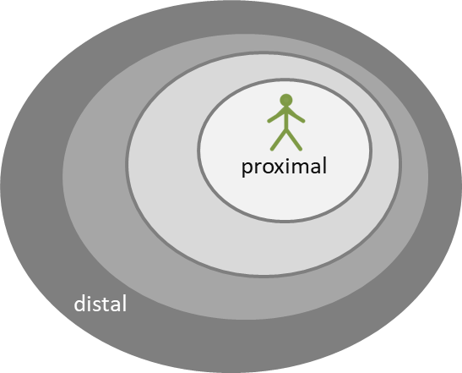
Preschool example
Since 1996, three-year-old children in Germany are entitled to attend preschool
Nowadays, 94.9% do attend preschools (DESTATIS, 2015)
Main aims of expanding preschool (cf. Hogrebe, 2014):
Compatibility of family and career
Improvement of preparation for school
Families and preschools are the most important learning environments for young children (cf. Bronfenbrenner, 1990; Bronfenbrenner & Morris, 2006)
Preschool is expected to foster later achievement (e.g. Knudsen et al., 2006)
Steinmann et al. (2016)

Slide 19
What could be selection mechanisms?

Slide 20
Preschool example
Selection into preschool
Family income
Parental education
Parental occupation
Availability of care options in family
Migration background
… (cf. Early & Burchinal, 2001; Grogan, 2012; Kim & Fram, 2009)
Steinmann et al. (2016)

Slide 21
Preschool example
PIRLS 2011: Positive relationship between preschool participation and reading abilities in fourth grade (Mullis et al., 2012)
Meta-analyses and reviews show substantial but rather mixed effects due to program types and target groups (Barnett, 2011; Burger, 2010; Camilli et al., 2010; Chambers et al., 2010; Duncan & Magnuson, 2013; Pianta et al., 2009)
Experimental studies: High/Scope Perry Preschool Project (Schweinhart et al., 2005) or Abecedarian Program (Campbell & Ramey, 1995)
Ca. 100 children with disadvantaged backgrounds
High intensity and quality of programs
Beneficial long-term effects on several outcomes in school age
→ Generalizability?
Steinmann et al. (2016)

Slide 22
Preschool example
More recent international studies could not (fully) replicate these promising findings (cf. Barnett, 2011)
Head Start study: No significant effects on later achievement (Puma et al., 2012)
Early Head Start study: Only reading ability effects for low risk students (Vogel et al., 2010)
Effective Provision of Preschool Education project: effects for high risk students (Sylva et al., 2008)
Effects for disadvantaged students in two out of nine countries (Hogrebe & Strietholt, 2016)
Basically no robust findings in Germany (Anders & Roßbach, 2014)
Steinmann et al. (2016)

Slide 23
Preschool example
What is the effect of attending preschool for 3 years or more (D = 1) on reading achievement in grade 4 in Germany, as compared to
not attending or attending for less than 3 years (D = 0)?

Slide 24
Preschool example
What is the effect of attending preschool for 3 years or more (D = 1) on reading achievement in grade 4 in Germany, as compared to
not attending or attending for less than 3 years (D = 0)?
We need
knowledge about the selection mechanisms at play
good observed control variables (associated with treatment allocation AND outcome) to capture the selection mechanisms
overlaps in characteristics between treatment and control groups
large enough datasets
appropriate regression model

Slide 25

Extended R example
see
CausalInference_Session5_Material1.R
PIRLS2016DEU.RData

Slide 26
What can we conclude from this exercise?
What is the causal effect of attending preschool for 3 or more years on reading achievement in grade 4?
What kind of limitations do we have to consider?

Slide 27
Questions?

Slide 28
Take-away messages
If selection mechanism is well-known and can be captured with indicators, regressions can control for selection mechanisms (in social sciences, this is usually not the case)
Omitted variable bias (i.e., selection bias) if control variables do not capture whole selection mechanism
If regressions used for causal research questions, importance of justification of control strategy, balance checks, and sensitivity analyses

Slide 29
Required reading for next week
5 | Regression Models Time: 31 January 2022, 12:15-14:00h Main instructor: Isa Steinmann Required reading: Angrist & Pischke (2015), chapter 2
6 | Further Control Strategies Time: 03 February 2022, 12:15-14:00h Main instructor: Isa Steinmann Required reading: -
7 | Instrumental Variable Approaches Time: 07 February 2022, 12:15-14:00h Main instructor: José Manuel Arencibia Alemán Required reading: Angrist & Pischke (2015), chapter 3
8 | Regression Discontinuity Designs I Time: 10 February 2022, 12:15-14:00h Main instructor: José Manuel Arencibia Alemán Required reading: Angrist & Pischke (2015), chapter 4

Slide 30
Thanks for your attention!
Isa Steinmann
isa.steinmann@cemo.uio.no

Slide 31
References
Anders, Y. & Roßbach, H.-G. (2014). Empirische Bildungsforschung zu Auswirkungen frühkindlicher, institutioneller Bildung: Internationale und nationale Ergebnisse. In Braches-Chyrek, R., Rühner, Ch., Sünker, H., & Hopf, M. (eds.), Handbuch frühe Kindheit (pp. 335–347). Opladen: Barbara Budrick.
Angrist, J. & Pischke, J.-S. (2015). Mastering `Metrics: The Path from Cause to Effect. Princeton University Press
Barnett, W. S. (2011). Effectiveness of early education interventions. Science, 333(6045), 975–978. doi:10.1126/ science.1204534.
Bronfenbrenner, U. (1990). The ecology of cognitive development. Zeitschrift für Sozialisationsforschung und Erziehungssoziologie, 10(2), 101–114.
Bronfenbrenner, U., & Morris, P. A. (2006). The bioecological model of human development. In W. Damon & R. M. Lerner (Eds.), Handbook of child psychology ((Series Ed.) 6 ed., Vol. 1, pp. 793–828). New York, NY: Wiley.
Burger, K. (2010). How does early childhood care and education affect cognitive development? An international review of the effects of early interventions for children from different social backgrounds. Early Childhood Research Quarterly, 25(2), 140–165. doi:10.1016/j.ecresq.2009.11.001.

Slide 32
References
Camilli, G., Vargas, S., Ryan, S., & Barnett, B. (2010). Meta-analysis of the effects of early education interventions on cognitive and social development. Teachers College Record, 112(3), 579–620. Retrieved from http://www.tcrecord.org/Content.asp?ContentId=15440.
Campbell, F. A., & Ramey, C. T. (1994). Effects of early intervention on intellectual and academic achievement: A followup study of children from low-income families. Child Development, 65(2), 684–698. doi:10.1111/j.1467-8624.1994.tb00777.x.
Chambers, B., Cheung, A., Slavin, R. E., Smith, D., & Laurenzano, M. (2010). Effective early childhood education programs: A systematic review. Retrieved from the Best Evidence Encyclopedia website: http://www.bestevidence.org/word/early_child_ed_Sep_22_2010.pdf.
DESTATIS (2015). Betreuungsquoten der Kinder unter 6 Jahren in Kindertagesbetreuung. Retrieved from https://www.destatis.de/DE/ZahlenFakten/GesellschaftStaat/Soziales/Sozialleistungen/Kindertagesbetreuung/Tabellen/Tabellen_Betreuungsquote.html
Duncan, G. J., & Magnusson, K. (2013). Investing in preschool programs. Journal of Economic Perspectives, 27(2), 109–132. doi:10.1257/jep.27.2.109.
Early, D. M., & Burchinal, M. R. (2001). Early childhood care: Relations with family characteristics and preferred care characteristics. Early Childhood Research Quarterly, 16(4), 475–497. doi:10.1016/S0885-2006(01)00120-X.

Slide 33
References
Grogan, K. E. (2012). Parents’ choice of pre-kindergarten: the interaction of parent, child and contextual factors. Early Child Development and Care, 182(10), 1265–1287. doi:10.1080/03004430.2011.608127.
Hogrebe, N. (2014). Bildungsfinanzierung und Bildungsgerechtigkeit. Der Sozialraum als Indikator für eine bedarfsgerechte Finanzierung von Kindertageseinrichtungen. Wiesbaden: Springer VS.
Hogrebe, N. & Strietholt, R. (2016). Does non-participation in pre-school affect children’s reading achievement? International evidence from propensity score analyses. Large-Scale Assessment in Education, 4(1), 1–22.
Kim, J., & Fram, M. S. (2009). Profiles of choice: Parents’ patterns of priority in child care decision-making. Early Childhood Research Quarterly, 24(1), 77–91. doi:10.1016/j.ecresq.2008.10.001.
Knudsen, E. I., Heckman, J. J., Cameron, J. L. & Shonkoff, J. P. (2006). Economic, neurobiological, and behavioral perspectives on building America’s future workforce. Proceedings of the National Academy of Sciences, 27, 10155–10162.
Mullis, I. V. S., Martin, M. O., Gonzalez, E. J. & Kennedy, A. M. (2003). PIRLS 2001 International Report: IEA’s Study of Reading Literacy Achievement in Primary Schools. Chestnut Hill, MA: Boston College.
Mullis, I. V. S., Martin, M. O., Kennedy, A. M. & Foy, P. (2007). IEA’s Progress in International Reading Literacy Study in Primary School in 40 Countries. Chestnut Hill, MA: Boston College.

Slide 34
References
Mullis, I. V. S., Martin, M. O., Foy, P., & Drucker, K. T. (2012). PIRLS 2011. International results in reading. Retrieved from http://timssandpirls.bc.edu/pirls2011/international-results-pirls.html.
Pianta, R., Barnett, W., Burchinal, M., & Thornburg, K. (2009). The effects of preschool education: What we know, how public policy is or is not aligned with the evidence base, and what we need to know. Psychological Science in the Public Interest, 10(2), 49–88. doi:10.1177/1529100610381908.
Puma, M., Bell, S., Cook, R., Heid, C., Broene, P., Jenkins, F., Mashburn, A., & Downer, J., (2012). Third grade follow-up to the Head Start impact study. Final report (OPRE report no. 2012-45). Retrieved from the Administration for Children and Families, US Department of Health and Human Services website: http://www.acf.hhs.gov/sites/default/files/opre/head_start_report.pdf
Schweinhart, L. J., Montie, J., Xiang, Z., Barnett, W. S., & Nores, M. (2005). Lifetime effects: The high/scope perry preschool study through age 40. Ypsilanti, MO: High/Scope Press.
Steinmann, I., Zieger, L. R., Hogrebe, N. & Strietholt, R. (2016). Lesen Kinder, die nicht in der Kita waren, am Ende der Grundschule schlechter? In R. Strietholt, W. Bos, H. G.Holtappels & N. McElvany (Eds.): Jahrbuch der Schulentwicklung Band 19: Daten, Beispiele und Perspektiven (pp. 161-185). Beltz Juventa

Slide 35
References
Sylva, K., Melhuish, E., Sammons, P., Siraj-Blatchford, I., & Taggart, B. (2008). The effective provision of pre-school education (EPPE) project: Final report from the primary phase: Pre-school, school and family influences on children’s development during key stage 2 (Age 7–11). Retrieved from the Institute of Education, University of London website: http://www.ioe.ac.uk/End_of_primary_school_phase_report.pdf.
Vogel, C. A., Xue, Y., Moiduddin, E. M., Carlson, B. L., & Kisker, E. E. (2010). Early Head Start children in grade 5: Long-term follow-up of the Early Head Start Research and Evaluation Study sample (OPRE report no. 2011-8). Retrieved from the Office of Planning, Research, and Evaluation, Administration for Children and Families, US Department of Health and Human Services website: http://www.acf.hhs.gov/programs/opre/resource/early-head-start-children-in-grade-5-long-term-followup-of-the-early-head.
Zachrisson, H. D., Janson, H., & Nærde, A. (2013). Predicting early center care utilization in a context of universal access. Early Childhood Research Quarterly, 28(1), 74–82. doi:10.1016/j.ecresq.2012.06.004.

